Slide 1
FINAL CAPSTONE PROJECT
Top and Safest sites Recommendation in Chicago
BY- Uma Shankar Bhagat

Slide 2
INTRODUCTION
My idea for the Capstone Project is to show that when driven by venue and location data from Foursquare, backed up with open source crime data, that it is possible to present the cautious and nervous traveller with a list of attractions to visit supplemented with a graphics showing the occurrence of crime in the region of the venue.
A high level approach is as follows:
The travellers decides on a city location [in this case Chicago]
The Foursquare website is scrapped for the top venues in the city
From this list of top venues the list is augmented with additional geographical data
Using this additional geographical data the top nearby restaurants are selects
The historical crime within a predetermined distance of all venues are obtained
A map is presented to the to the traveller showing the selected venues and crime statistics of the area.
The future probability of a crime happening near or around the selected top sites is also presented to the user
Who is this solution targeted at ?
This solution is targeted at the cautious traveller. The want to see all the main sites of a city that they have never visited before but at the same time, for whatever reasons unknown, they want to be able to do all that they can to make sure that they stay clear of trouble i.e. is it safe to visit this venue and this restaurant at 4:00 pm in the afternoon.
Some examples of envisioned users include:
A single white female traveller
An elderly traveller that has had previous back experiences when travelling

Slide 3
DATA DESCRIPTION
In this section, I will describe the data used to solve the problem as described previously.
As noted below in the Further Development Section, it is possible to attempt quite complex and sophisticated scenarios when approaching this problem. However, given the size of the project and for simplicity only the following scenario will be addressed:
Query the Foursquare website for the top sites in Chicago
Use the Foursquare API to get supplemental geographical data about the top sites
Use the Foursquare API to get top restaurant recommendations closest to each of the top site
Use open source Chicago Crime data to provide the user with additional crime data
https://data.cityofchicago.org/d/aerh-rz74

Slide 4
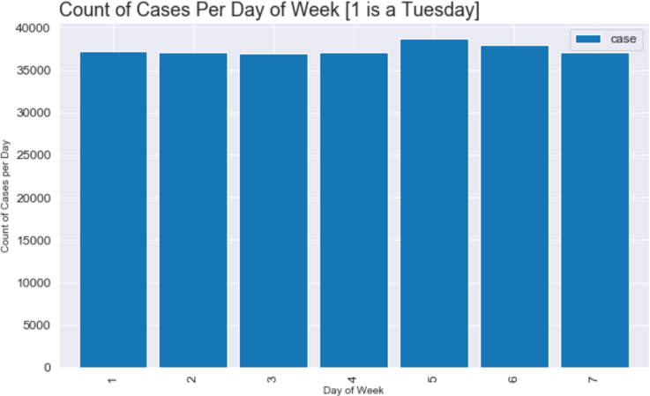
VISUALISATION
To get a better understanding of the data we will now visualise it. The number of crimes per month, day and hour were calculated:
There is a small increase in crime reported at the weekend, Saturday and Sunday, but nothing that could be considered significant.

Slide 5
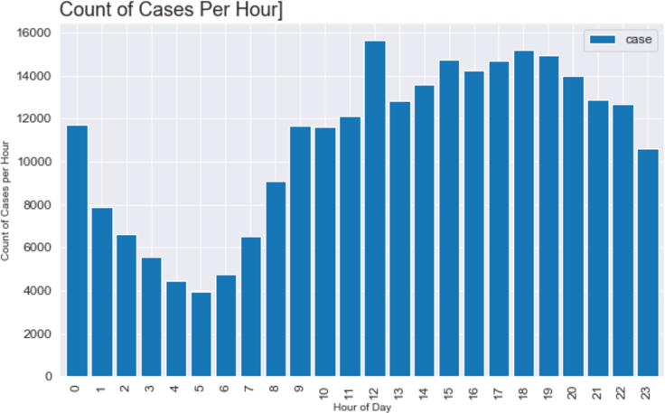
There is an expected fall-off in reported crime rates after midnight before elevating again after eight in the morning. There appears to be a spike around midday.

Slide 6
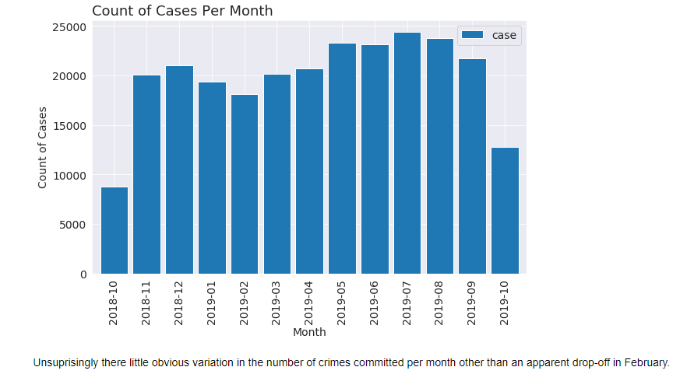

Slide 7
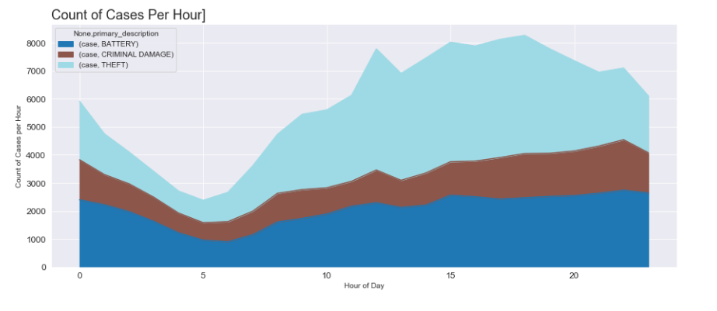

Slide 8
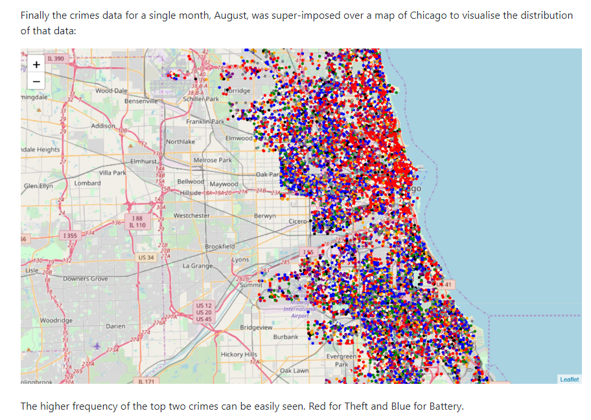

Slide 9
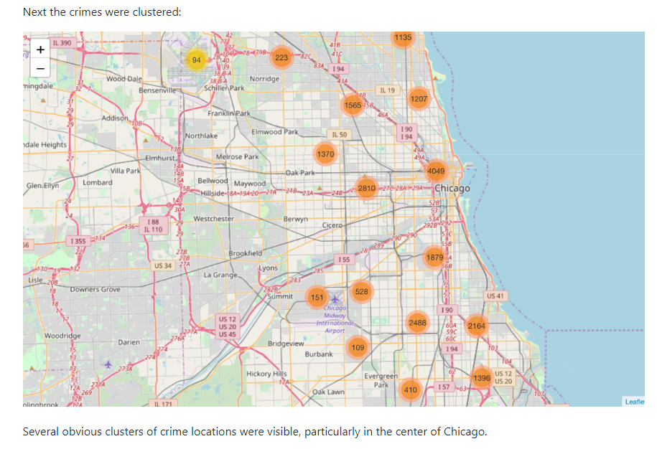

Slide 10
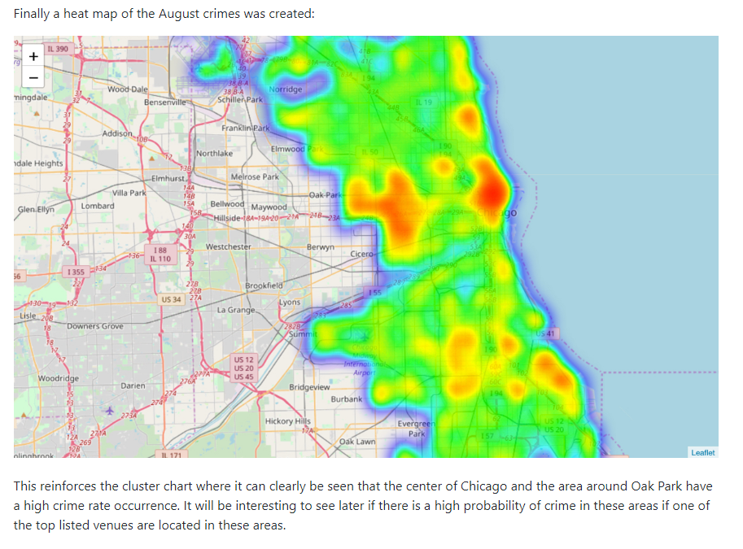

Slide 11
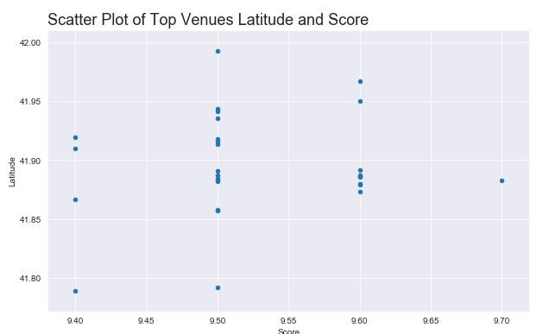
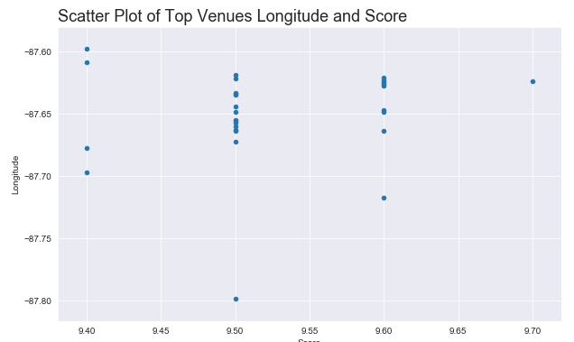
METHODOLOGY
Methodology section which represents the main component of the report where we discuss and describe any exploratory data analysis that we did, any inferential statistical testing that you performed, and what machine learning's were used and why.
Exploratory Data Analysis :
The first round of exploratory analysis was to examine the Top Venues and Restaurants Dataframes to determine if there was any correlation between variables.
Unfortunately the only data attributes that could be analysed were the Latitude and Longitude attributes and their relationship to the venues score. Top venues was examined First.
Although nothing obvious to would appear that the top venues are centered around the -87.65 Longitude.

Slide 12
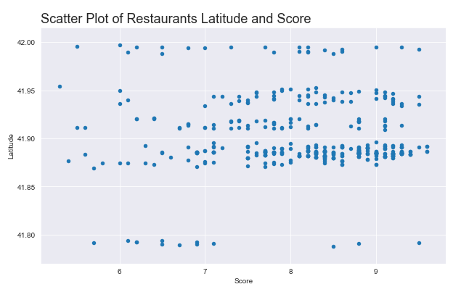
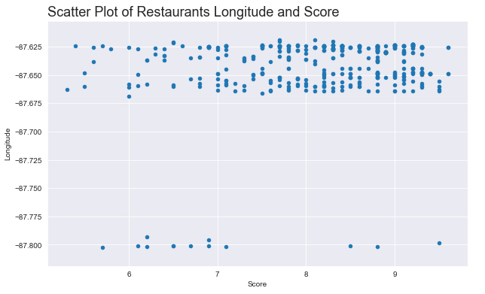
Restaurant data was examined next.
Unsurprisingly the Restaurant data is also clustered around the -87.65 Longitude given that Restaurants with 500 meters of the top venues were selected.

Slide 13
FURTHER VISUALISATION
Because it was not possible, because of the categorical nature of the data, to do more details inferential statistical analysis of the data further exploratory visualisation was undertaken. It would be important for the traveller to see the crime, venue and restaurant data presented in this manner.
In each of the Top 10 Venues:
All crimes within 750 meters of the venue are added to a dataframe
All restaurants associated with the venue are added to a dataframe
A folium Map is created centred on the venue
A heat map of the crimes in the area are overlayed
the venue is marked on the map
The top 10 scored restaurants are marked on the map
The Top Venue is shown using a blue marker, the restaurants are shown using a red marker. Also shown is the heatmap of crimes within 750 meters over the course of the entire previous year. The hotter, redder, the heatmap the more crimes there are recorded. Some Restaurants, for example the two located at the top left of the map, appear to be in areas where crime is quite frequent. On the other hand others are in areas which are obviously not as crime ridden.

Slide 14
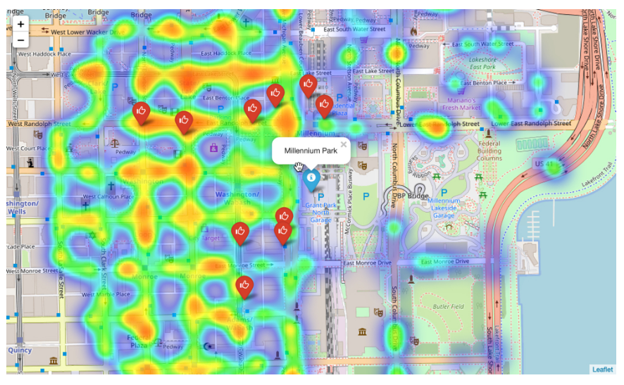

Slide 15
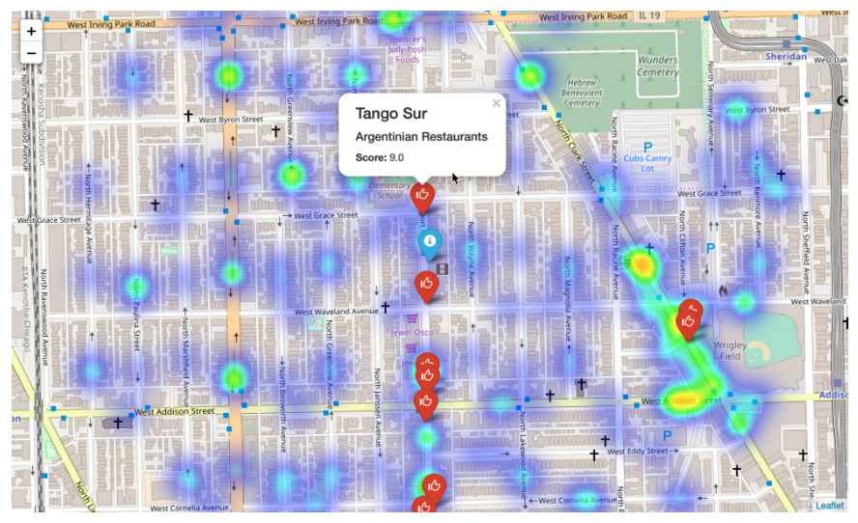

Slide 16
MODELLING
Before we start modelling we need to prepare the data frame to include only numerical data and by removing unneeded columns.
Rather than removing columns from df_crimes a new df_features DataFrame was created with just the required columns. This df_features DataFrame was then processed to remove Categorical Data Types and replace them with One Hot encoding. Finally the Dependent Variables were Normalized.
Five model type were then chosen to be evaluated:
K Nearest Neighbours
Decision Trees
Logistics Regression
Naive Bayes
Decision Forest using a Random Forest

Slide 17
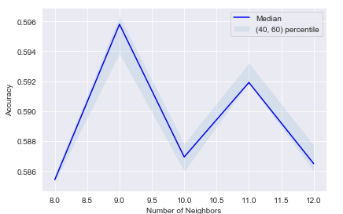
K nearest neighbour :
KNN Model was quick to execute and through the process of evaluation it was discovered the K = 9 gave the best results.

Slide 18
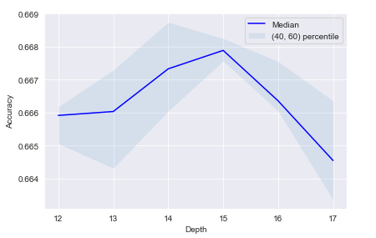
Decision Tree :
A decision tree is a decision support tool that uses a tree-like graph or model of decisions and their possible consequences, including chance event outcomes, resource costs, and utility.
The Decision Tree model was particularly fast taking only 10 seconds per model. This meant that it was easy to try multiple different parameters. A tree depth of 15 gave the best model performance:

Slide 19
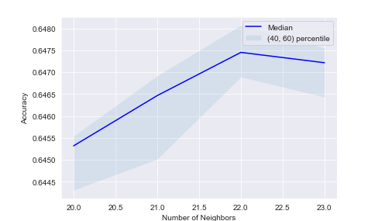
Logistic Regression & Naive Bayes :
Logistic Regression and Naive Bayes models did not return any models with an accuracy greater that 0.61.
Decision Forest using a Random Forest:
Random forests or random decision forests are an ensemble learning method for classification, regression and other tasks, that operate by constructing a multitude of decision trees at training time and outputting the class that is the mode of the classes (classification) or mean prediction (regression) of the individual trees. Random decision forests correct for decision trees' habit of over fitting to their training set.
Each model took approximately 40 seconds to create and 22 estimators was found to give the best model accuracy.

Slide 20
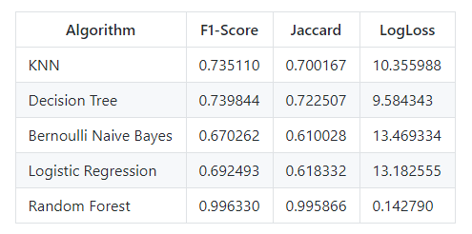
Best Model :
Using the crime data for the top two occurring crimes each of the top performing models where further evaluated to determine which model performed the best using F1-Score, Jaccard Score and Log Loss.
Random forest was determined to be the best model.

Slide 21
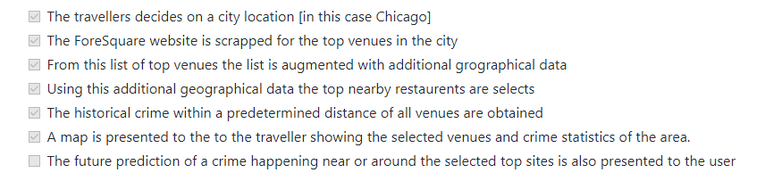
RESULTS AND PREDICTION
Let's review the goals of this project.
The idea for the Capstone Project is to show that when driven by venue and location data from Foursquare, backed up with open source crime data, that it is possible to present the cautious and nervous traveller with a list of attractions to visit supplemented with a graphics showing the occurrence of crime in the region of the venue.
A high level approach is as follows:

Slide 22
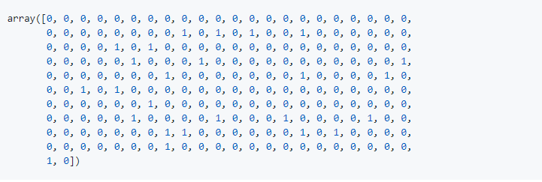
Test Data
The test data was contracted from the Top Venues Data Frame and the Restaurants Dataframe as follows:
The two data frames were joined together to form a single dataframe. The venue or restaurant name and the latitude and longitude attributes were added.
Duplicate entries were dropped as some restaurants appeared multiple times in the dataframe
Next a random date and time was assigned to each venue.
The date was then split into Hour, Day of Week, Month and Year as described above
The data was finally prepared for prediction by applying One Hot encoding and then extracted into a new dataframe that match the format used to create the model.
y^ (y_hat) or the predictions were then made.
The results of the predictions are shown below

Slide 23
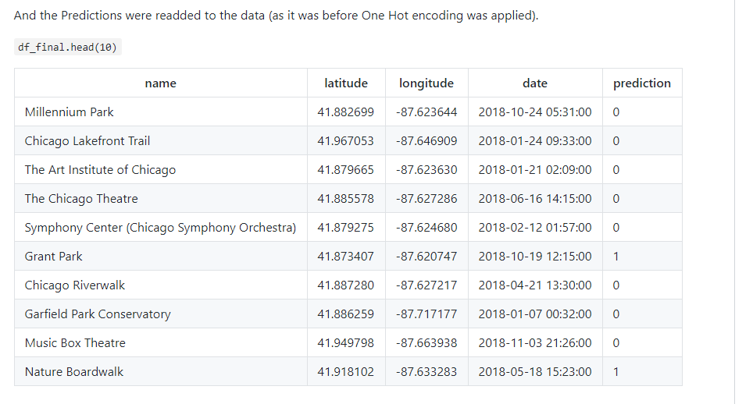

Slide 24
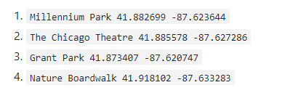
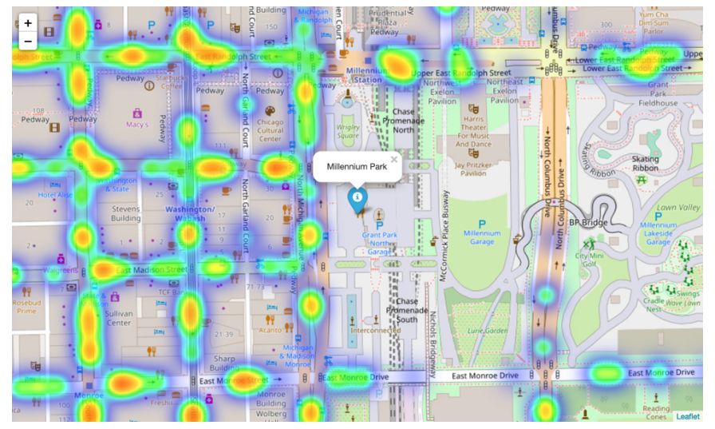
Of the top ten venues 8 were identified as potentially dangerous to visit and 2 were deems safe. As there is no data to compare the predictions against the best way we will visualise the data again.
We will look at the following 4 venues:

Slide 25
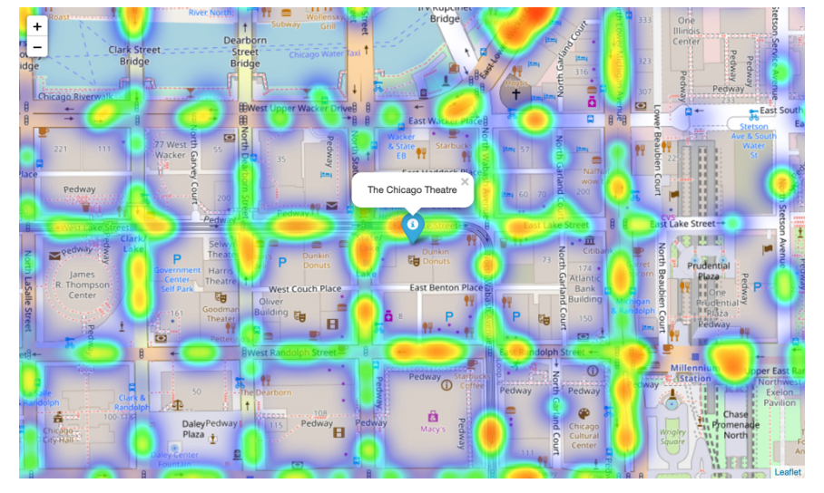

Slide 26
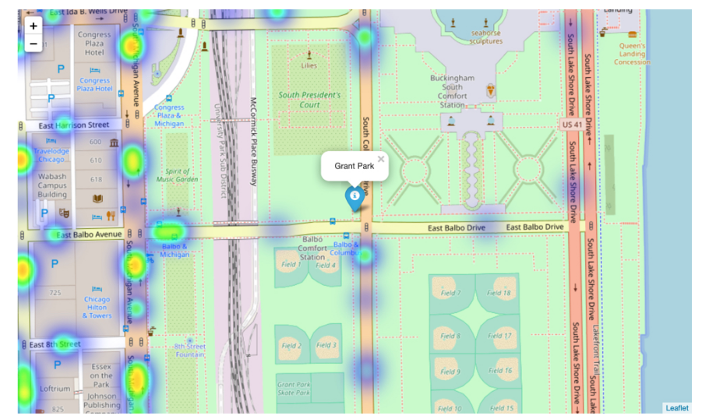

Slide 27
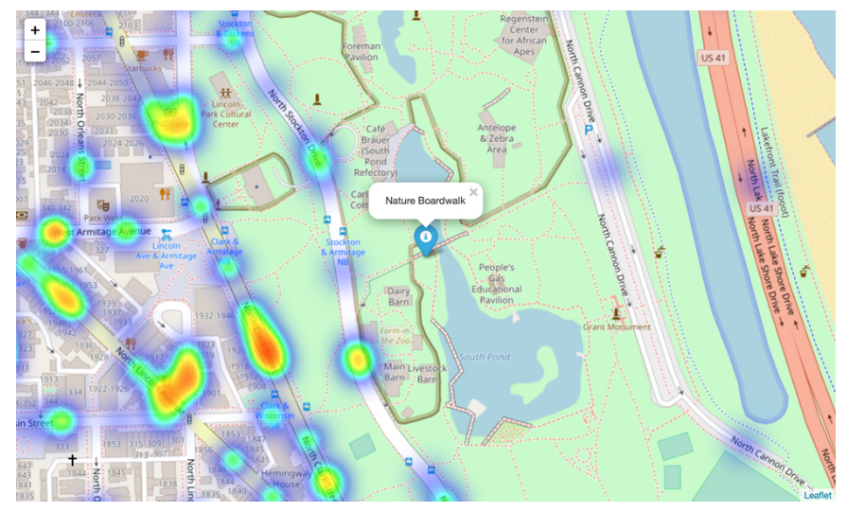
These images are from Grant Hill and Nature Boardwalk. Although both show signs of criminal activity, both have far less than Millennium Park and The Chicago Theatre.

Slide 28
CONCLUSION & FUTURE DEVELOPMENT
Although all of the goals of this project were met there is definitely room for further improvement and development as noted below. However, the goals of the project were met and, with some more work, could easily be developed into a fully pledged application that could support the cautious traveller in an unknown location.
Of the contributing data the Chicago Crime data is the one where more data would be good to have. Also not every city in the world makes this data freely available so that is a drawback.
FourSquare proved to be a good source of data but frustrating at times. Despite having a Developer account I regularly exceeded my hourly limit locking me out for the day. This is why Pickle was used to store the captured data.
Further Development :
The following are suggestions how this project could be further developed:
Best time to visit each venue
Suggestions for morning, afternoon, evening and night time
Daily itineraries
Route planning and transportation
Time lapse of the crime in the area of the venue
Favourite dining preferences could be used to choose the restaurants

